Slide 1
‘Being loved into life’
Session 3: What do we do with lament?
St Peter’s Ruddington
Lent Course 2025

Slide 2
Group Discussions
Have there been times this week when you have been more conscious of the Holy Spirit initiating prayer? What has this looked like?
Over half the Psalms contain Lament. To what extent does lament form part of your normal prayer activity.

Slide 3
‘Being loved into life’
Session 3: What do we do with lament?
St Peter’s Ruddington
Lent Course 2025

Slide 4
Lament:
‘to express profound sorrow for; to bewail’.

Slide 5


Slide 6
Biblical Lament:
‘the unsettling biblical tradition of prayer that includes expressions of complaint, anger, grief, despair, and protest to God’

Slide 7
‘Being loved into life’
Session 3: What do we do with lament?
St Peter’s Ruddington
Lent Course 2025

Slide 8
Lament strengthens our relationship with God
Real relationship is deeply interactive. Boundaries, authority and responsibility are negotiated and discussed.
God is not oppressive and coercive, he is aways available if we wish to express out doubt and uncertainty
In relationships within our families and wider society, the opportunity to appeal for justice must always be available
The throne of God must be a place that that hears the cry for justice. It cannot be only a place of unquestioning praise.

Slide 9
‘Being loved into life’
Session 3: What do we do with lament?
St Peter’s Ruddington
Lent Course 2025

Slide 10
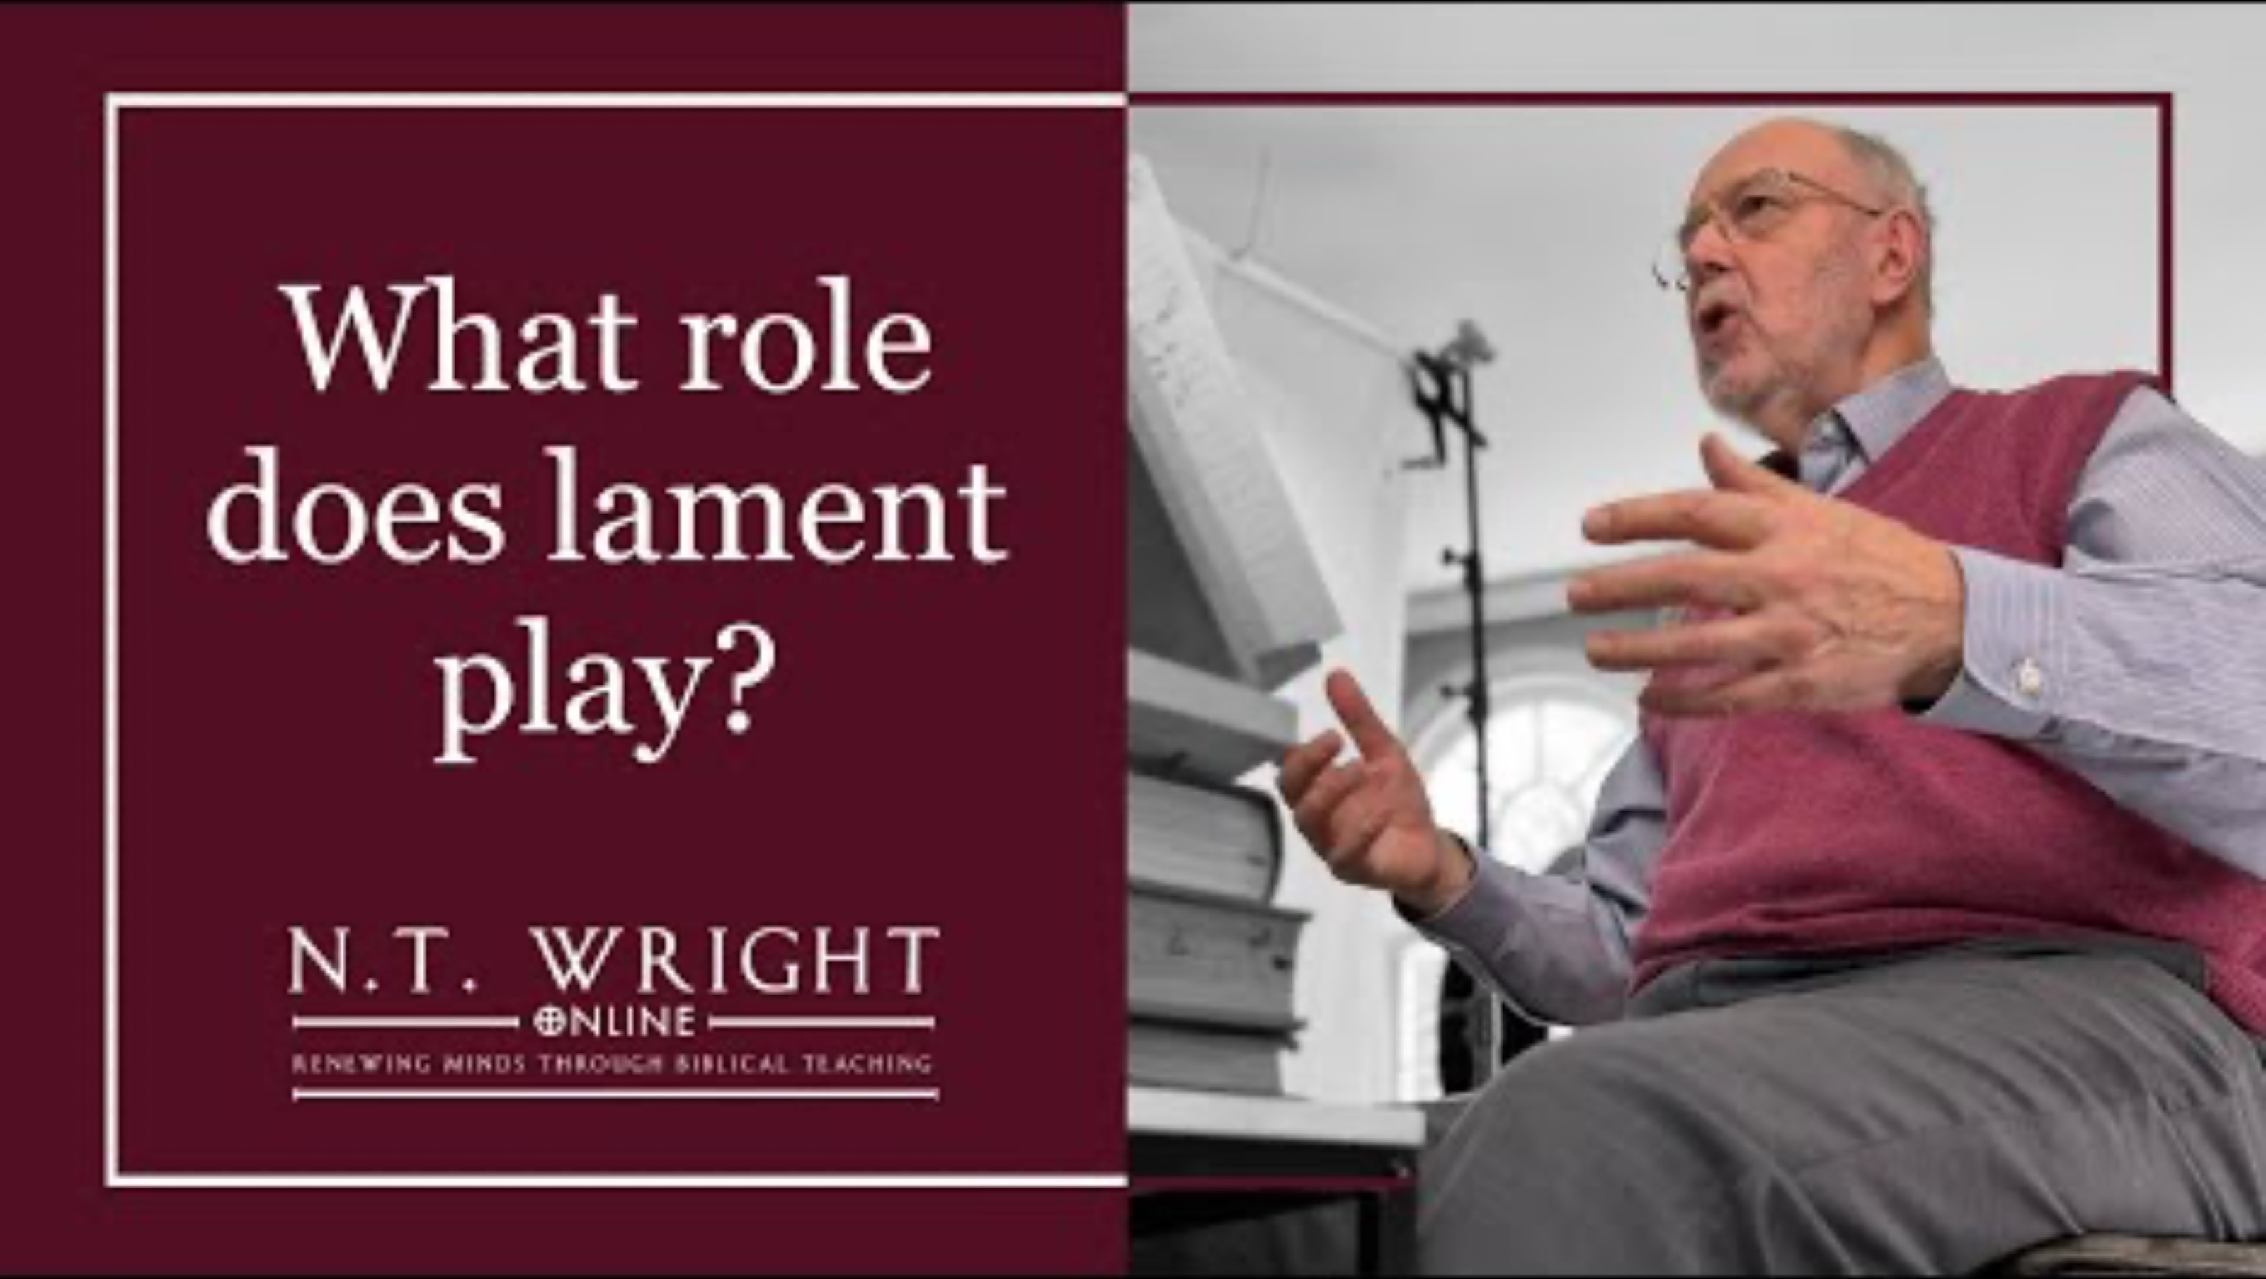

Slide 11
‘Being loved into life’
Session 3: What do we do with lament?
St Peter’s Ruddington
Lent Course 2025

Slide 12
We know that the whole creation has been groaning as in the pains of childbirth right up to the present time. Not only so, but we ourselves, who have the first fruits of the Spirit, groan inwardly as we wait eagerly for our adoption to sonship,…..
Romans 8:22-23

Slide 13
In the same way, the Spirit helps us in our weakness. We do not know what we ought to pray for, but the Spirit himself intercedes for us through wordless groans. And he who searches our hearts knows the mind of the Spirit, because the Spirit intercedes for God’s people in accordance with the will of God.
Romans 8:26-27

Slide 14
‘the moment we address our lament upwards in prayer to the true God…. And when that prayer is heard in heaven, it becomes something more than the outpouring of human sorrow. It contains within itself, by the ministry of the Spirit who groans in and through our prayers, the seeds of a future rescue, and therefore of praise.’
Tim Ash, Teaching Psalms, Vol 1

Slide 15
“…God’s dwelling place is now among the people, and he will dwell with them. They will be his people, and God himself will be with them and be their God.
He will wipe every tear from their eyes. There will be no more death or mourning or crying or pain, for the old order of things has passed away.”
Revelation 21: 3,4

Slide 16
Group Discussion
Have you ever complained or lamented to God in your prayers. What sort of subjects might provoke lament
It has been suggested that lament is part of the Christian vocation, interceding in the places of greatest pain in the world. Do our prayers normally tend to be too small?
What problems might you encounter in developing more lament into your prayer life? And how might they be overcome?

